Slide 1

Big Data Applied Algorithms
Lecture 3
Rong-Hua Li
School of Computer Science & Technology
Beijing Institute of Technology

Slide 2
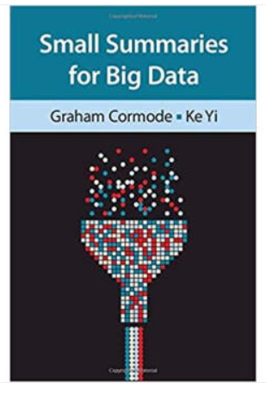
Course Information
Tuesday and Friday
中文班 9:55-11:30 研究生楼208
English Class 13:20-14:55 研究生楼606
Grade: 50% final exam, 50% Homework (or quiz)
Recommended Books (PDF available: http://dimacs.rutgers.edu/~graham/ssbd.html)

Slide 3
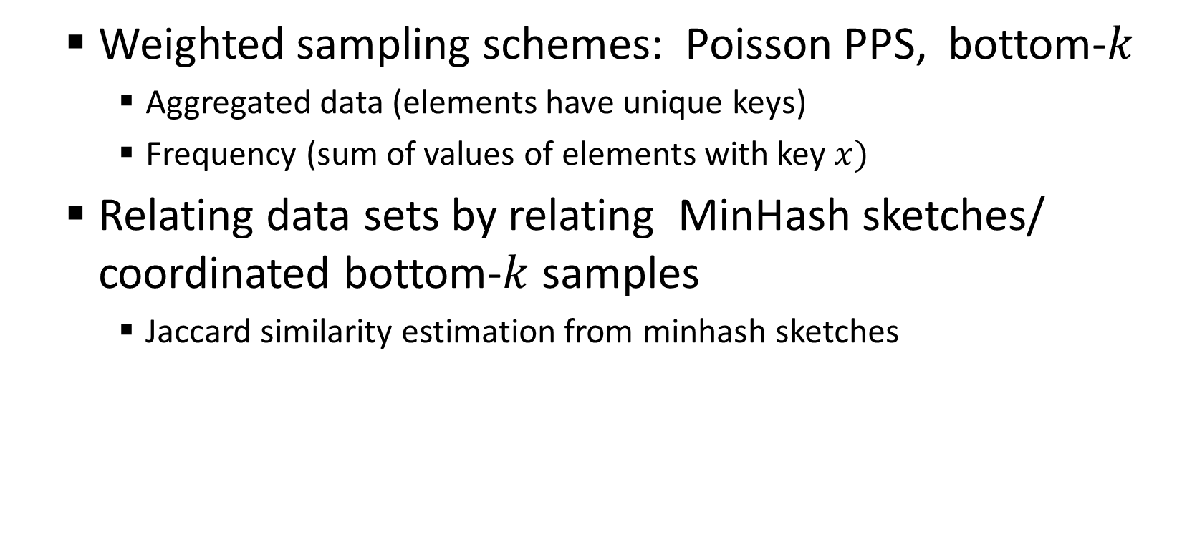
Overview
Weighted sampling schemes: Poisson PPS, bottom-$k$
Aggregated data (elements have unique keys)
Frequency (sum of values of elements with key $x)$
Relating data sets by relating MinHash sketches/ coordinated bottom-$k$ samples
Jaccard similarity estimation from minhash sketches

Slide 4

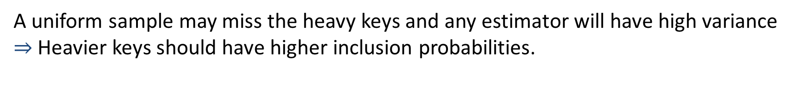

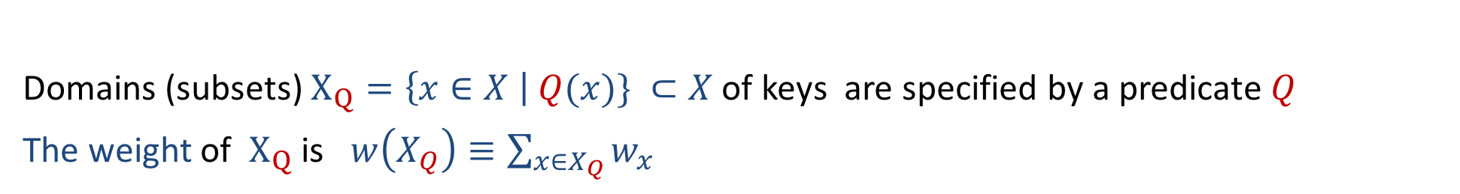
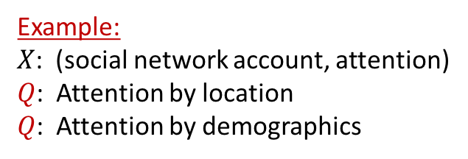

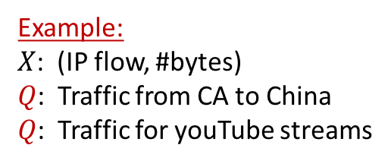

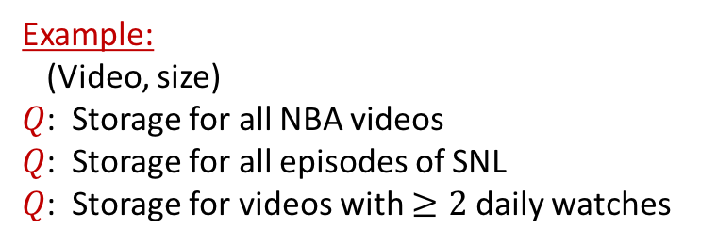


Weighted Sampling
Key value pairs: Each key $x∈X$ has weight $w_{x}≥0$
Domains (subsets) $X_{Q}=\left\{x∈X \right| Q(x)\} ⊂X$ of keys are specified by a predicate $Q$
The weight of $X_{Q}$ is $w\left(X_{Q}\right)≡\sum_{x∈X_{Q}}{w_{x}}$
We want a small sample $S⊂X$ from which we can estimate $w\left(X_{Q}\right)$ for query $Q$
Example:
$X$: (IP flow, #bytes)
$Q$: Traffic from CA to China
$Q$: Traffic for youTube streams
Example:
$X$: (social network account, attention)
$Q$: Attention by location
$Q$: Attention by demographics
$$w_{1}$$
$$w_{2}$$
Example:
(Video, size)
$Q$: Storage for all NBA videos
$Q$: Storage for all episodes of SNL
$Q$: Storage for videos with $≥2$ daily watches
$$w_{3}$$
$$w_{4}$$
$$w_{5}$$
$$w_{6}$$
A uniform sample may miss the heavy keys and any estimator will have high variance $⇒$ Heavier keys should have higher inclusion probabilities.

Slide 5
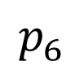

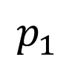
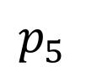

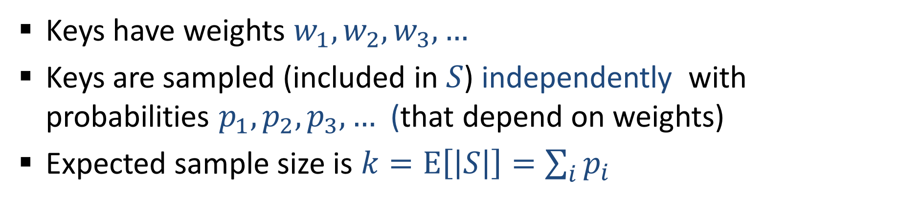
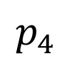

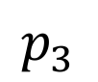
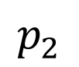
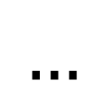

Poisson Sampling
Keys have weights $w_{1},w_{2},w_{3},…$
Keys are sampled (included in $S$) independently with probabilities $p_{1},p_{2},p_{3},…$ (that depend on weights)
Expected sample size is $k=E\left[\left|S\right|\right]=\sum_{i}{p_{i}}$
$$p_{1}$$
$$p_{2}$$
$$w_{1}$$
$$p_{3}$$
$$p_{4}$$
$$w_{2}$$
$$p_{5}$$
$$w_{3}$$
$$p_{6}$$
$$w_{4}$$
$$w_{5}$$
$$w_{6}$$
$$…$$

Slide 6
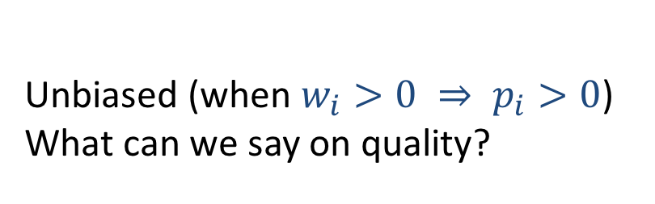
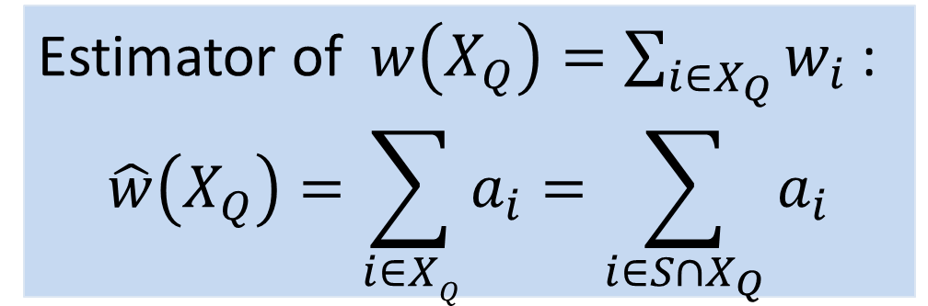

Poisson Samples: Subset Weight Estimation
Inverse probability: If $i∈S$, $a_{i}=\frac{w_{i}}{p_{i}}$ Else $a_{i}=0$
!! Need to know $w_{i}$ and $p_{i}$ when $i∈S$
Estimator of $w\left(X_{Q}\right)=\sum_{i∈X_{Q}}{w_{i}}$ :
$$\hat{w}\left(X_{Q}\right)=\sum_{i∈XQ}{a_{i}}=\sum_{i∈S∩X_{Q}}{a_{i}}$$
$$p_{1}$$
$$p_{2}$$
$$w_{1}$$
$$p_{3}$$
$$p_{4}$$
Sum Estimator = sum of per-key estimates
$$w_{2}$$
$$p_{5}$$
$$w_{3}$$
$$p_{6}$$
$$w_{4}$$
$$w_{5}$$
Unbiased (when $w_{i}>0 ⇒ p_{i}>0$)
What can we say on quality?
$$w_{6}$$
$$…$$

Slide 7
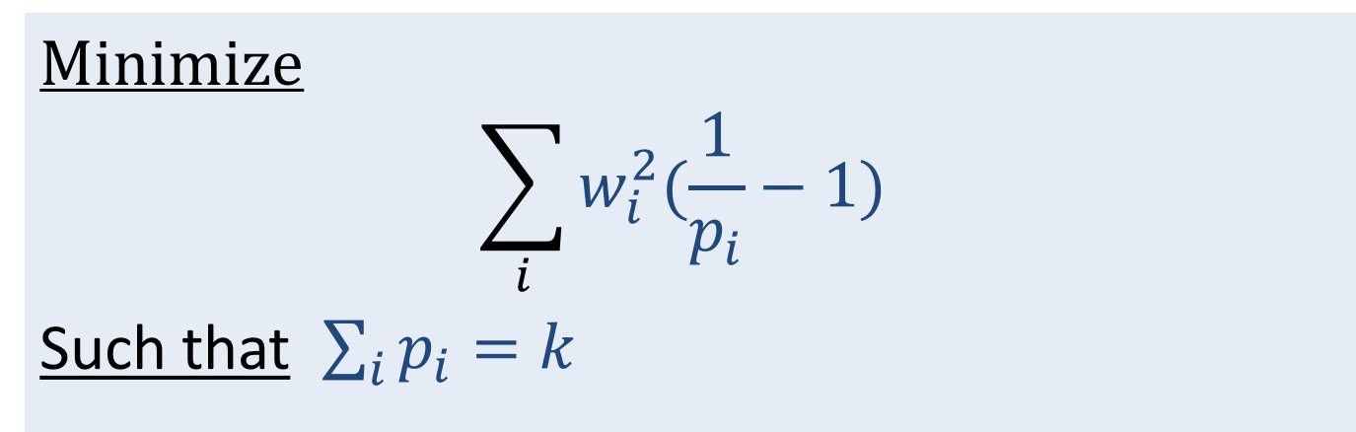
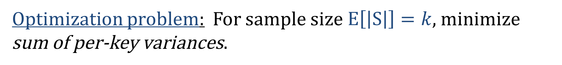
Poisson Sampling: Which $p_{i}$ minimizes variance?
$$Var\left[a_{i}\right]=w_{i}^{2}\left(\frac{1}{p_{i}}−1\right) Var\left[\hat{w}\left(X\right)\right]=\sum_{i}{Var[a_{i}]}$$
Optimization problem: For sample size $E\left[\left|S\right|\right]=k$, minimize sum of per-key variances.
Minimize
$$\sum_{i}{w_{i}^{2}(\frac{1}{p_{i}}−1) }$$
Such that $\sum_{i}{p_{i}}=k$
(variance of population weight estimate, expected variance of a “random” subset)
Notes:
Suppose we try to estimate the sum from the individual inverse probability estimates. We sometimes know the sum. But minimizing that also minimizeds variance for “Average” subsets of certain size.

Slide 8
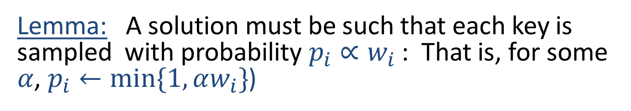
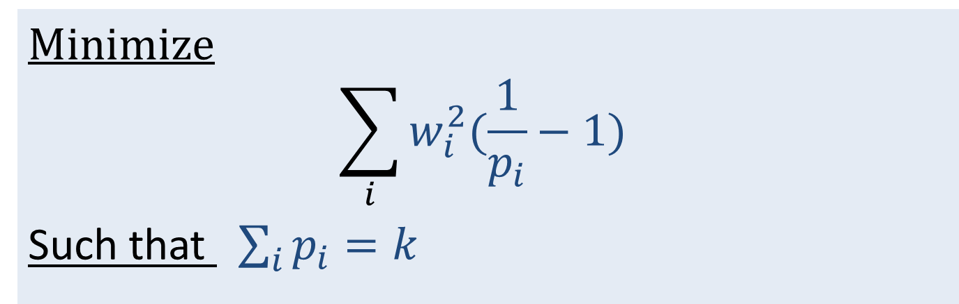
Probability Proportional to Size (PPS)
Minimize
$$\sum_{i}{w_{i}^{2}(\frac{1}{p_{i}}−1) }$$
Such that $\sum_{i}{p_{i}}=k$
Lemma: A solution must be such that each key is sampled with probability $p_{i}∝w_{i}$ : That is, for some $α$, $p_{i}←min\{1,αw_{i}\}$)
We show proof for 2 items…
Notes:
Alpha proportion factor. We truncate to 1, since these are probabilites.

Slide 9
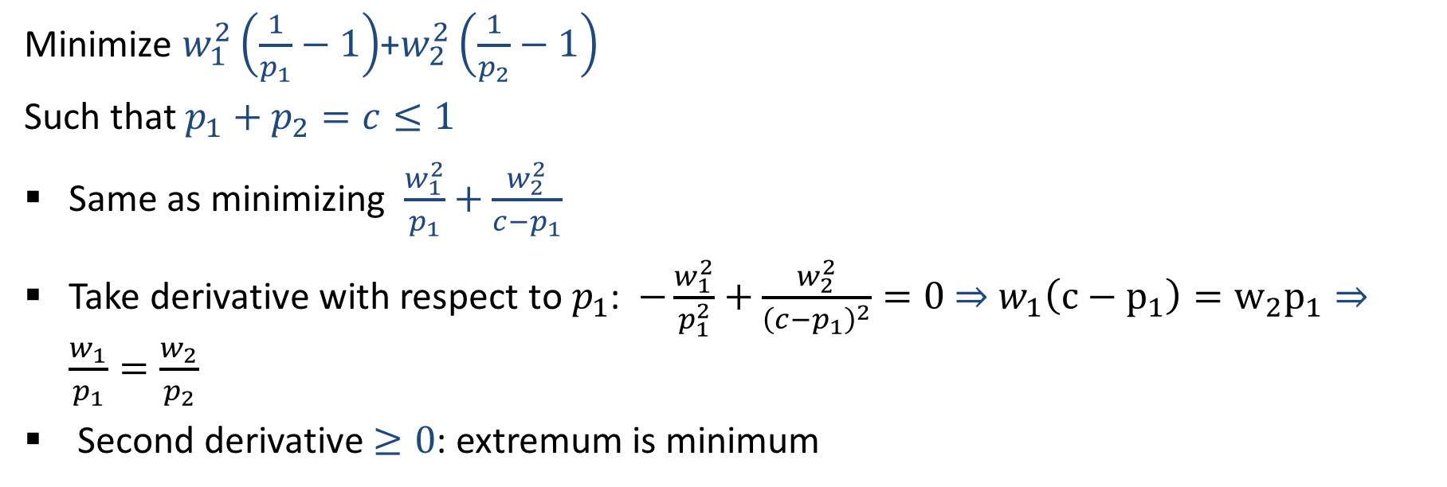
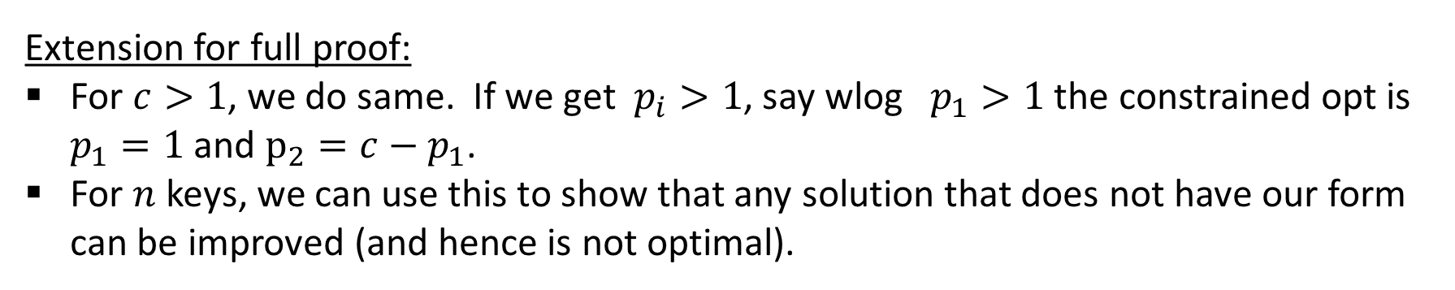
PPS minimizes variance: 2 keys
Minimize $w_{1}^{2}\left(\frac{1}{p_{1}}−1\right)$+$w_{2}^{2}\left(\frac{1}{p_{2}}−1\right)$
Such that $p_{1}+p_{2}=c≤1$
Same as minimizing $\frac{w_{1}^{2}}{p_{1}}+\frac{w_{2}^{2}}{c−p_{1}}$
Take derivative with respect to $p_{1}$: $−\frac{w_{1}^{2}}{p_{1}^{2}}+\frac{w_{2}^{2}}{{\left(c−p_{1}\right)}^{2}}=0$ $⇒$ $w_{1}\left(c−p_{1}\right)=w_{2}p_{1}⇒$ $\frac{w_{1}}{p_{1}}=\frac{w_{2}}{p_{2}}$
Second derivative $≥0$: extremum is minimum
Extension for full proof:
For $c>1$, we do same. If we get $p_{i}>1$, say wlog $p_{1}>1$ the constrained opt is $p_{1}=1$ and $p_{2}=c−p_{1}$.
For $n$ keys, we can use this to show that any solution that does not have our form can be improved (and hence is not optimal).
Notes:
If c>1 can solve, but it one p_i>1, then round down.

Slide 10
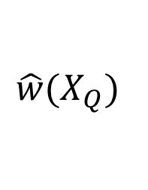
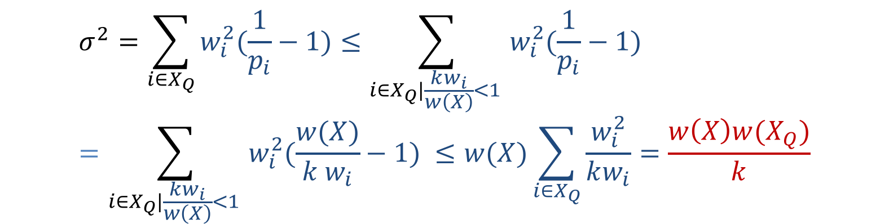
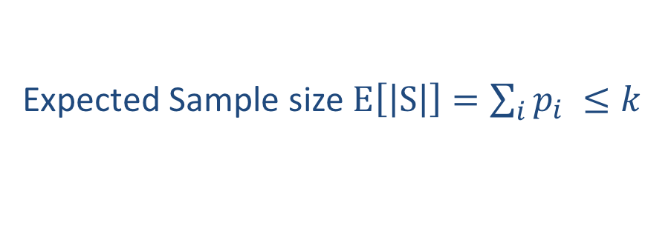
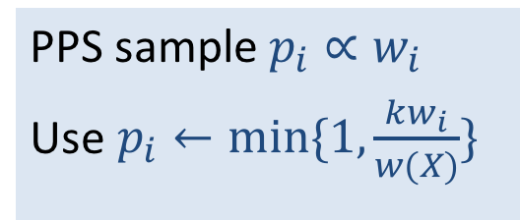
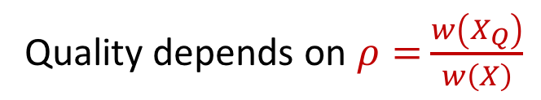
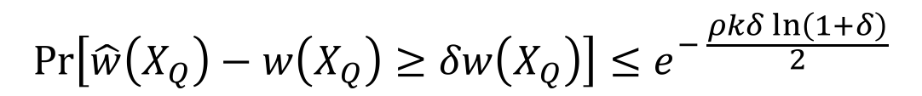
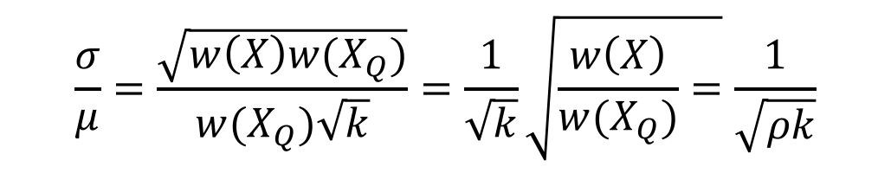
PPS: Estimation Quality of subset weight
PPS sample $p_{i}∝w_{i}$
Use $p_{i}←min\{1,\frac{kw_{i}}{w(X)}\}$
Expected Sample size $E\left[\left|S\right|\right]=\sum_{i}{p_{i} }≤k$
Quality depends on $ρ=$ $\frac{w\left(X_{Q}\right)}{w\left(X\right)}$
$$\hat{w}(X_{Q})$$
$$σ^{2}=\sum_{i∈X_{Q}}{w_{i}^{2}(\frac{1}{p_{i}}−1)≤\sum_{i∈X_{Q}|\frac{kw_{i}}{w\left(X\right)}<1 }{w_{i}^{2}(\frac{1}{p_{i}}−1) }}=\sum_{i∈X_{Q}|\frac{kw_{i}}{w\left(X\right)}<1 }{w_{i}^{2}(\frac{w(X)}{k w_{i}}−1) }≤w(X)\sum_{i∈X_{Q}}{\frac{w_{i}^{2}}{kw_{i}}=\frac{w\left(X\right)w(X_{Q})}{k}}$$
Variance:
$$\frac{σ}{μ}=\frac{\sqrt{w\left(X\right)w(X_{Q})}}{w(X_{Q})\sqrt{k}}=\frac{1}{\sqrt{k}}\sqrt{\frac{w\left(X\right)}{w(X_{Q})}=}\frac{1}{\sqrt{ρk}}$$
CV:
$$Pr\left[\hat{w}\left(X_{Q}\right)−w\left(X_{Q}\right)≥δw\left(X_{Q}\right)\right]≤e^{− \frac{ρkδ ln\left(1+δ\right)}{2}}$$
Chernoff concentration e.g.:

Slide 11

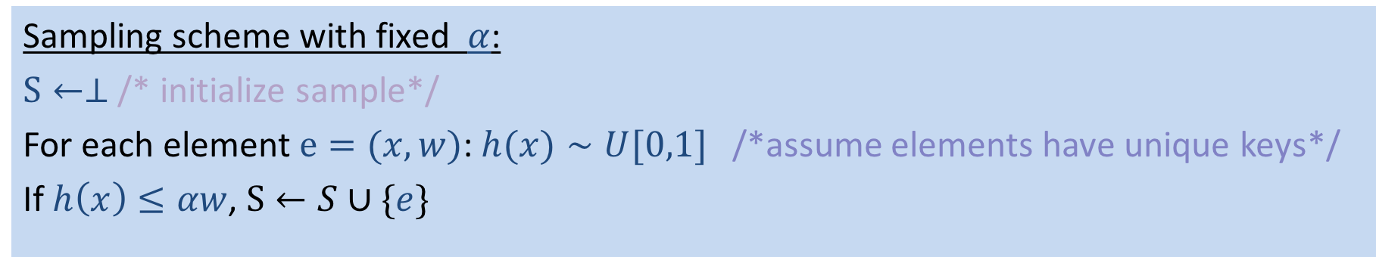
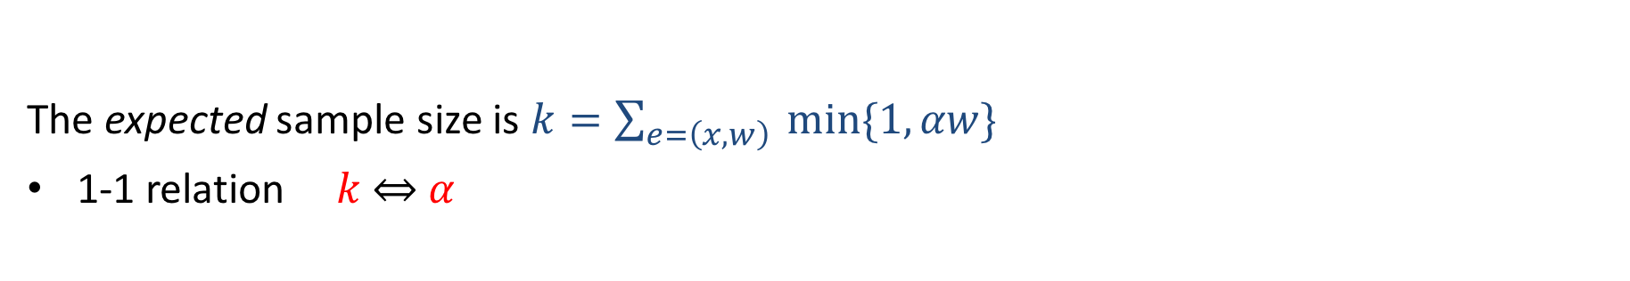
PPS scheme by proportion factor $α$
PPS: $p(e=(x,w))∝w$ . Choose $α>0$: $p←min\{1,αw\}$
Sampling scheme with fixed $α$:
$S←⊥$ /* initialize sample*/
For each element $e=(x,w)$: $h(x)∼U[0,1]$ /*assume elements have unique keys*/
If $h\left(x\right)≤αw$, $S←S∪\{e\}$
The expected sample size is $k=\sum_{e=\left(x,w\right)}{ min\{1,αw\}}$
1-1 relation $k$ $⇔$ $α$
For large data sets, we’d like a composable sampling scheme with a fixed sample size $k$
Idea: decrease $α$ on the go to to keep $k$ fixed $⇔$ bottom-$k$ $e=(x,w)$ with respect to $\frac{h(x)}{w}$
* Other methods to get fixed-size weighted sample Rejective sampling, Varopt sampling [Chao 1982] [CDKLT2009],

Slide 12
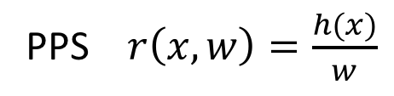
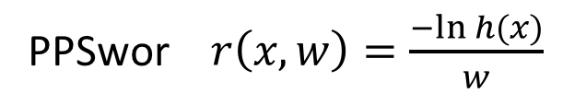
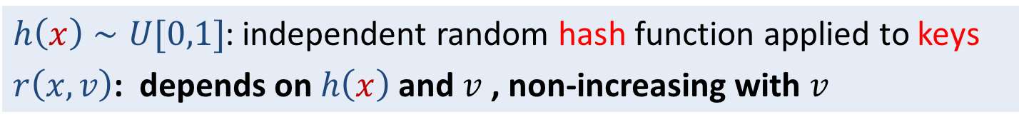
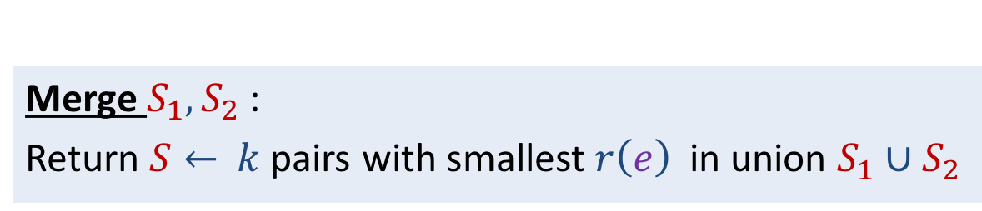
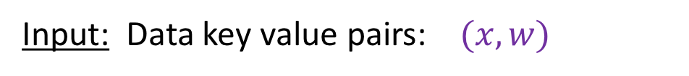
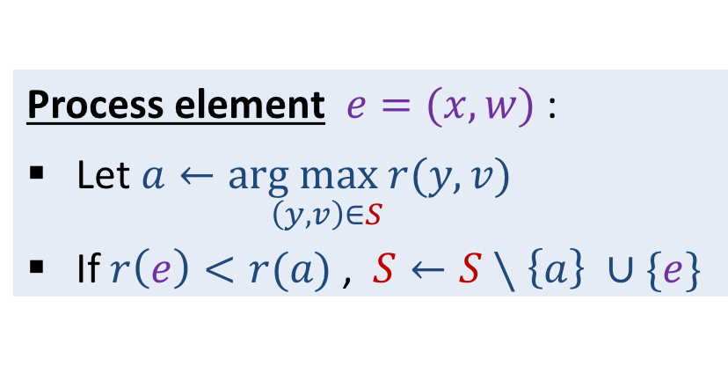
bottom-$k$/order/weighted-reservoir sample: General form
Stat: [Rosen 1972,1997] [Ohlsson 1990+]
CS: [Duffield Lund Thorup 2007], [C 1997], [Efraimidis Spirakis 2006], [CK 2007]
Input: Data key value pairs: $(x,w)$
Assume for now: Elements have unique keys
$h\left(x\right)∼U[0,1]$: independent random hash function applied to keys
$r\left(x,v\right)$: depends on $h\left(x\right)$ and $v$ , non-increasing with $v$
PPS $r\left(x,w\right)=\frac{h(x)}{w}$
PPSwor $r\left(x,w\right)=\frac{−ln h(x)}{w}$
Bottom-$k$ sample $S←$ $k$ pairs with smallest $r\left(e\right)$
Initialize: $S←⊥$ set can hold $≤k$ key value pairs
Process element $e=(x,w)$:
Let $\underset{\left(y,v\right)∈S}{a←arg max r(y,v)}$
If $r\left(e\right)<r(a)$ , $S←S∖\left\{a\right\} ∪\{e\}$
Merge $S_{1}, S_{2}$:
Return $S←$ $k$ pairs with smallest $r\left(e\right)$ in union $S_{1}∪S_{2}$

Slide 13
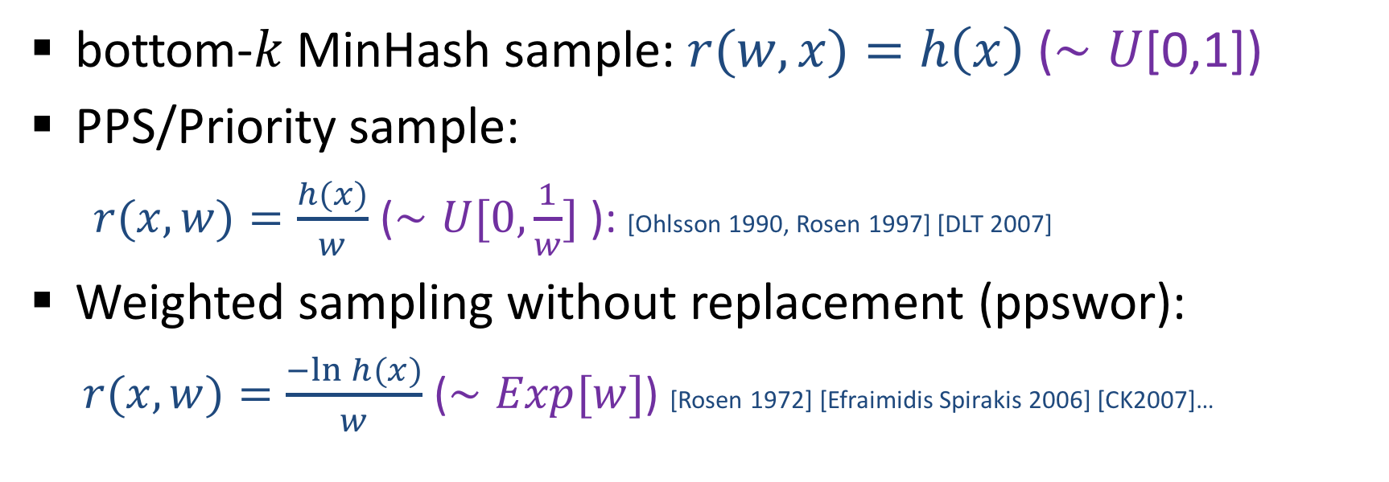

Useful $r(x,w)$
Bottom-$k$ sample $S←$ $k$ pairs with smallest $r\left(e\right)$
bottom-$k$MinHash sample: $r(w,x)=h\left(x\right)$ ($∼U$[0,1])
PPS/Priority sample:
$r(x,w)=\frac{h(x)}{w}$ ($∼U[0,\frac{1}{w}]$ ): [Ohlsson 1990, Rosen 1997] [DLT 2007]
Weighted sampling without replacement (ppswor):
$r(x,w)=\frac{−ln h(x)}{w}$ ($∼Exp[w]$) [Rosen 1972] [Efraimidis Spirakis 2006] [CK2007]…

Slide 14
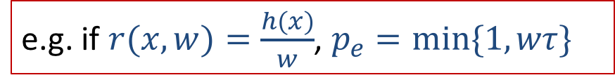
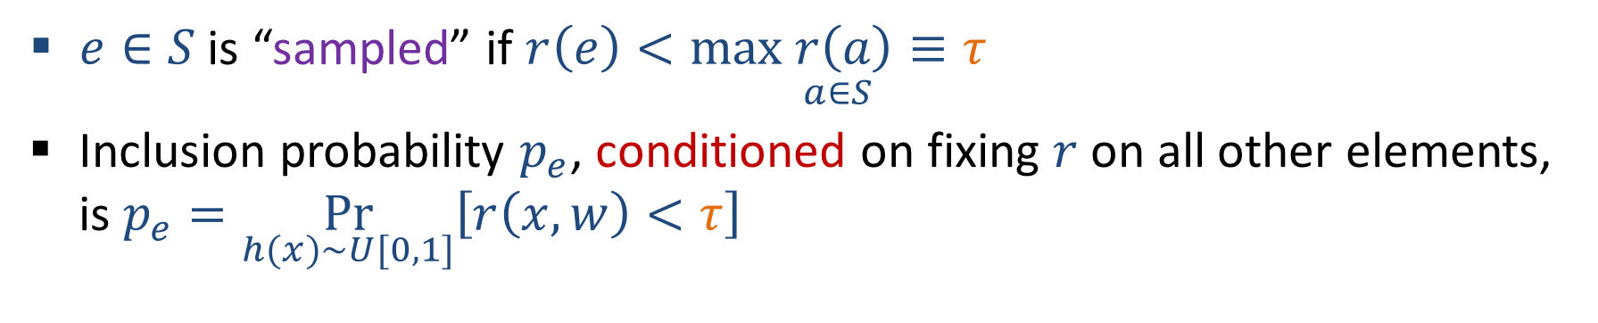
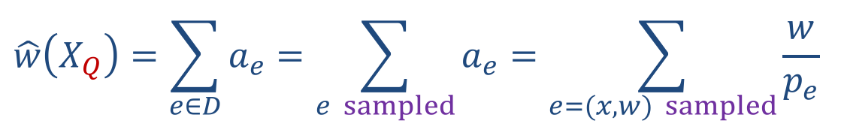
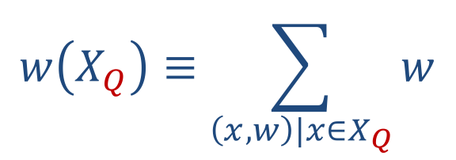
Weighted bottom-$k$: Inverse probability estimates for subset weight
Similar to estimating “presence” with MinHash sketches….
$$w\left(X_{Q}\right)≡\sum_{\left(x,w\right)|x∈X_{Q}}{w}$$
Estimate $a_{e}≥0$ for each $e=(x,w)$ in data: $E\left[a_{e}\right]=w$
Inverse probability: $a_{e}=0$ ($e$ not “sampled”), $a_{e}=\frac{w}{p_{e}}$ (is sampled)
$e∈S$ is “sampled” if $r\left(e\right)<\underset{a∈S}{max r\left(a\right)≡τ}$
Inclusion probability $p_{e}$, conditioned on fixing $r$ on all other elements, is $p_{e}=\underset{h(x)∼U[0,1]}{Pr}\left[r\left(x,w\right)<τ\right]$
e.g. if $r(x,w)=\frac{h(x)}{w}$, $p_{e}=min\{1,wτ\}$
$$\hat{w}\left(X_{Q}\right)=\sum_{e∈D}{a_{e}=\sum_{e sampled}{a_{e}}=\sum_{e=(x,w) sampled}{\frac{w}{p_{e}}}}$$

Slide 15
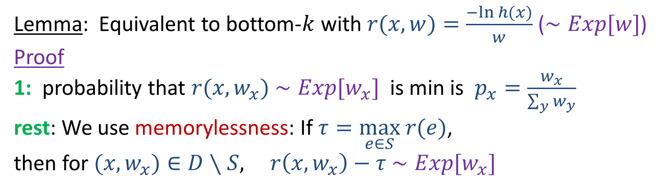
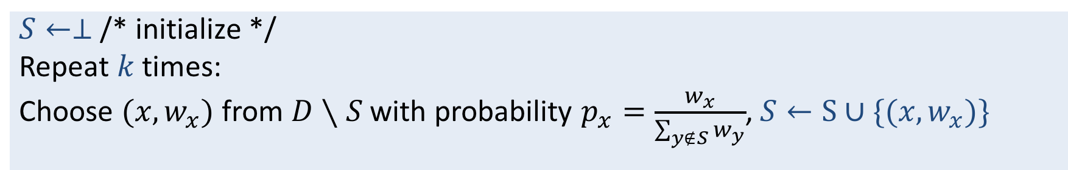
Weighted Sampling without Replacement (ppswor)
$S←⊥$ /* initialize */
Repeat $k$ times:
Choose $(x,w_{x})$ from $D∖S$ with probability $p_{x}=\frac{w_{x}}{\sum_{y∉S}{w_{y}}}$, $S←S∪\{(x,w_{x})\}$
Lemma: Equivalent to bottom-$k$ with $r(x,w)=\frac{−ln h(x)}{w}$ ($∼Exp[w]$)
Proof
1: probability that $r(x,w_{x})$ $∼Exp[w_{x}]$ is min is $p_{x}=\frac{w_{x}}{\sum_{y}{w_{y}}}$
rest: We use memorylessness: If $τ=\max_{e∈S} r(e)$,
then for $(x,w_{x})∈D∖S,$ $r\left(x,w_{x}\right)−τ$ $∼Exp[w_{x}]$

Slide 16
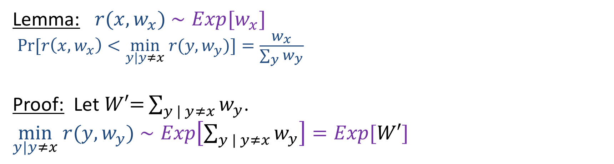
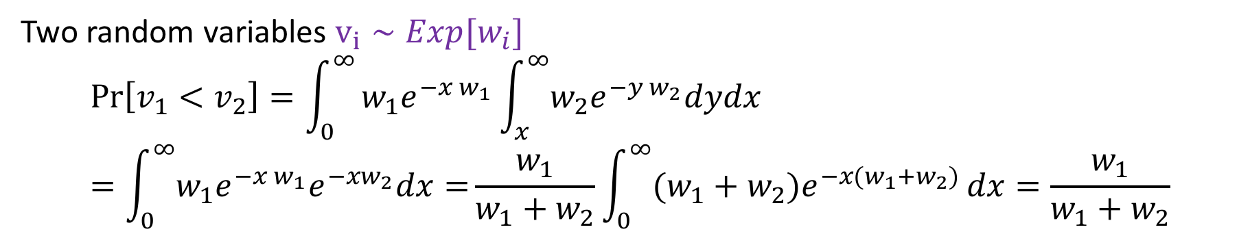
Weighted Sampling without Replacement (ppswor)
Lemma: $r(x,w_{x})$ $∼Exp[w_{x}]$
$Pr[r\left(x,w_{x}\right)<\min_{y|y≠x} r(y,w_{y})]=\frac{w_{x}}{\sum_{y}{w_{y}}}$
Proof: Let $W′\text{=}\sum_{y | y≠x}{w_{y}}$.
$\min_{y|y≠x} r(y,w_{y})$ $∼Exp\left[\sum_{y | y≠x}{w_{y}}\right]=Exp[W′]$
Two random variables $v_{i}∼Exp[w_{i}]$
$$\operatorname{Pr}\left[v_{1}<v_{2}\right]=\int_{0}^{∞}{w_{1}e^{−x w_{1}}\int_{x}^{∞}{w_{2}e^{−y w_{2}}dydx}}=\int_{0}^{∞}{w_{1}e^{−x w_{1}}e^{−xw_{2}}dx=}\frac{w_{1}}{w_{1}+w_{2}}\int_{0}^{∞}{{(w_{1}+w_{2})e}^{−x(w_{1}+w_{2})}}dx=\frac{w_{1}}{w_{1}+w_{2}}$$

Slide 17
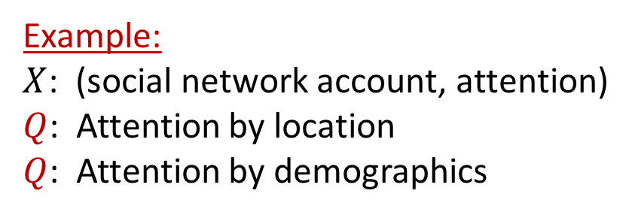

Unaggregated data elements
10
8
5
1
17
2
1
2
2
We presented weighted sampling schemes for data elements $e=(x,w)∈D$ with unique keys.
Example:
$X$: (IP flow, #bytes)
$Q$: Traffic from CA to China
$Q$: Traffic for youTube streams
Example:
$X$: (social network account, attention)
$Q$: Attention by location
$Q$: Attention by demographics
!! Raw data elements are IP packets:
(IP flow key, #bytes)
!!Raw data elements are “likes”/”re-tweet”:
(account key, 1 )
Multiple data elements share the same key
The weight of a key is the sum of values of elements with that key

Slide 18
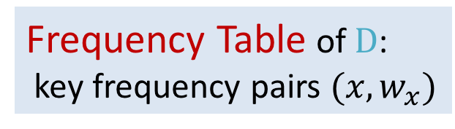
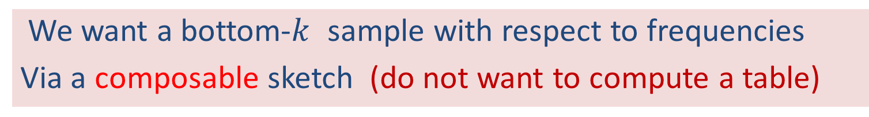

Weighted Sampling by frequency
10
8
5
1
17
2
1
2
2
Frequency (weight) of a key $x$:
Frequency Table of $D$:
key frequency pairs $(x,w_{x})$
$w_{x}=\underset{e=\left(x,v\right)∈D }{∑ v}$
11
7
3
17
We want a bottom-$k$ sample with respect to frequencies
Via a composable sketch (do not want to compute a table)
Notes:
For each unique key we can consider a weight or “frequency” which is the sum of values of all elements with that key. When all values are “1” the weight is the number of elements with that key
We can aggregate this data to a table of key frequency pairs. The number of entries is the number of distinct keys in the data.
We are interested in statistics of the aggregated data, but “Aggreagation” is costly: We need to store and move around large tables.

Slide 19






Ppswor bottom-$k$ by frequency
Initialize: Empty $S$ that can hold $≤k$ (key,rank) pairs
Correctness (sample is ppswor)
$r\left(x\right):$ “rank” of key $x$ =
Smallest score over elements with key $x$
Claim: $r\left(x\right)∼Exp[w_{x}]$ (min of Exp r.v.s)
Process element $e=(x,w)$:
Let $\underset{\left(y,r′\right)∈S}{a=(y,τ)←arg max r}$’
“score” $r∼Exp[w]$
If $r<τ$ , If $(x,r^{′})∈S$, replace it with $(x,min\left(r,r^{′}\right))$
Else, $S ←S∖\left\{a\right\} ∪\{e\}$
Sketch contains $k$ keys with smallest rank
Catch: Estimation –
Do not have $w_{x}$ for sampled keys.
Solution: second pass, or more complex estimators
Merge $S_{1}, S_{2}$:
Unique union $S_{1}∪S_{2}$: Duplicate keys replaced by one with min rank
$S←$ $k$ pairs with smallest rank
Notes:
Can get frequencies in another pass. Or can use more sophisticated estimators.

Slide 20
Next: Data sets relations from sketches
LSH property of MinHash sketches and coordinated samples
Estimating relations of data sets from their sketches
Modeling using features, sketches for scalability
Example: Near-duplicate detection in text documents
n-gram features
Jaccard similarity estimation from minhash sketches

Slide 21



Relations of data sets from their sketches
View data sets as vectors (key=position, entry=value)
$$D_{1}$$
(0, 0, 1, 0, 1, 1, 0, 0, 1…)
$$D_{2}$$
(1, 0, 1, 1, 0, 1, 0, 1, 0…)
MinHash sketches $S(D_{1})$ $S(D_{2})$ (same hash functions)
“Locality Sensitive Hashing” (LSH): Similar data sets have similar sketches

Slide 22

Relations of data sets from their sketches
View weighted data sets as weighted vectors (key=position, entry=value)
4, 2, 7, 5
$$D_{1}$$
(0, 0, 4, 0, 2, 7, 0, 0, 5…)
3,2,1,1 0, 7
$$D_{2}$$
(3, 0, 2, 1, 0, 10, 0, 7, 0…)
Bottom-$k$ samples $S(D_{1})$ $S(D_{2})$ (coordinated: same hash functions)
“Locality Sensitive Hashing” (LSH): Similar data sets have similar sketches

Slide 23


Useful relations that can be estimated from minhash sketches/coordinated samples
Nearest neighbors structures: Find $A_{j}$ close to $A_{i}$
Distance norms ${||A}_{j}−A_{i}|{\left.​\right|}_{p}^{p}=\sum_{h}{{\left|A_{jh}−A_{ih}\right|}^{p}}$,
Growth-only norm $\sum_{h}{max{\left\{0, A_{jh}−A_{ih}\right\}}^{p}}$
Cosine similarity $\frac{{A_{i}⋅A}_{j}}{\left|\left|A_{i}\right|\right| |\left|A_{j}\right||}$
Size of union $\sum_{h}{\max_{i} A_{ih}}$
(weighted) Jaccard similarity $\frac{\sum_{h}{\min_{i} A_{ih}}}{\sum_{h}{\max_{i} A_{ih}}}$
Robust statistics (sum of medians) $\sum_{h}{\underset{i}{median} A_{ih}}$
$$A_{i}=(A_{i1},A_{i2},A_{i3},…,A_{in})$$
Intensive computations over full data sets is replaced by working with their small sketches

Slide 24


Weighted Jaccard
Similarity of weighted (nonnegative) vectors
Sum of min over sum of max
$$J\left(V,U\right)=\frac{\sum_{i}{min\{V_{i},U_{i}\}} }{\sum_{i}{max\{V_{i},U_{i}\}} }$$
$V=(0.00, 0.23,$0.00, 0.00, 0.03, 0.00, 1.00,0.13)
$U=(0.34, 0.21,$ 0.00, 0.03, 0.05, 0.00,1.00, 0.00)
$min=(0.00, 0.21,$ 0.00, 0.00, 0.03, 0.00, 1.00, 0.00)
$max=(0.34, 0.23,$ 0.00, 0.03, 0.05, 0.00, 1.00, 0.13)
$$J\left(V,U\right)=\frac{1.24 }{\text{1.78} }$$

Slide 25



Cosine Similarity
$$θ$$
Similarity measure between two vectors: The cosine of the angle between the two vectors.
$$C\left(U,V\right)=\frac{V⋅U}{{\left|\left|V\right|\right|}_{2}{\left|\left|U\right|\right|}_{2}}$$
Euclidean Norm: ${\left|\left|V\right|\right|}_{2}=\sqrt{\sum_{i}{V_{i}^{2}}}$

Slide 26
Relation from sketches: Applications
Pattern changes, Anomaly detection
Search (find results similar to query)
Detect Plagiarism, copyright violations
Classification (find nearest labeled entities)
Semi-supervised learning: Use similarities to extend labels of entities
Influence/coverage of sets of entities
Diversity in search results (show different types of results)
….

Slide 27









Search example
?
User issues a query (over images, movies, text document, Webpages)
Search engine finds many relevant documents:
Doc $1$
Doc $3$
Doc $2′$
Doc $1′$
Doc $3′$
Doc $2$
Doc $2′′$
Doc $1′′$
Doc $3′′$
Notes:
First-cut results based on similarity query between query and corpus

Slide 28
Elimination of near duplicates
Redundant information – many documents are very similar. Want to eliminate near-duplicates
Doc $1$
Doc $3$
Doc $2′$
Doc $1′$
Doc $3′$
Doc $2$
Doc $2′′$
Doc $1′′$
Doc $3′′$

Slide 29
Elimination of near duplicates
Doc $3$
Doc $1′$
Doc $2$

Slide 30



Elimination of near duplicates
Return to the user a concise, informative, diverse, result.
Doc $1$
Doc $2′$
Return to user
Doc $3$
Identifying Near-duplicates. Exact dups are easy (hash/signature)

Slide 31




Document Similarity
Modeling:
Identify a set of good features
Identify a similarity measure
Sketch the set of features (keys) of each document
$$D_{1}$$
(0,0,1,0,1,1,0…)
$$S(D_{1})$$
$$D_{2}$$
(1,0,1,1,1,1,0,…)
$$S(D_{2})$$
Notes:
Feature selection requires good modeling of the type of similarity we want to capture.
Sketching is to make the whole think scalable.

Slide 32

Similarity of text documents
What is a good set of features ?
Detect documents on similar topic
bag of words: Features = words (terms)+TF/IDF weighting…
Detect near-duplicates [Broder ‘97]
$n$-grams “shingles”: Features = ordered sets of $n$consecutive words
All 3-grams in “one fish two fish red fish blue fish”:
one fish two
two fish red
red fish blue
fish two fish
fish red fish
fish blue fish
!!MinHash sketch of the features can be computed in a linear pass over the text document

Slide 33




Jaccard Similarity
Similarity measure of two sets
Features $N_{1}$ of document 1
Features $N_{2}$ of document 2
$$J\left(N_{1},N_{2}\right)=\frac{{|N}_{1}∩N_{2}| }{{|N}_{1}∪N_{2}| }$$
Ratio of size of intersection to size of union:
$$J=\frac{3}{8}=0.375$$

Slide 34



Jaccard Similarity from MinHash sketches
$$J\left(N_{1},N_{2}\right)=\frac{{|N}_{1}∩N_{2}| }{{|N}_{1}∪N_{2}| }$$
For each $N_{i}$ we have a MinHash sketch ${s(N}_{i})$
(use the same hash function/s $h$ for all sets)
Merge ${s(N}_{1})$ and ${s(N}_{2})$ to obtain ${s(N}_{1}∪N_{2})$
For each $x∈{s(N}_{1}∪N_{2})$ we know everything on its membership in $N_{1}$ or $N_{2}:$
${ x∈s(N}_{1}∪N_{2})$ is in $N_{i}$ if and only if ${x∈s(N}_{i})$
In particular, we know if $x∈N_{1}∩N_{2}$
$J$ is the fraction of union members that are intersection members: apply subset ratio estimator to ${s(N}_{1}∪N_{2})$

Slide 35












$k$-mins sketches: Jaccard estimation
$k=4$
$s\left(N_{1}\right)=(0.22, 0.11$, 0.14, 0.22)
$s\left(N_{2}\right)=(0.18, 0.24$, 0.14, 0.35)
$s\left({N_{1}∪N}_{2}\right)=(0.18, 0.11$, 0.14, 0.22)
$${∈N}_{1}∖N_{2}$$
$${∈N}_{2}∖N_{1}$$
$${∈N}_{1}∩N_{2}$$
$$\hat{α}=\frac{2}{4}=\frac{1}{2}$$
$$\hat{α}=\frac{1}{4}$$
$$\hat{α}=\frac{1}{4}$$
$⇒$ Can estimate $α= \frac{{{|N}_{1}∖N}_{2}|}{|N_{1}∪N_{2}|}$ , $\frac{{{|N}_{2}∖N}_{1}|}{|N_{1}∪N_{2}|}$, $\frac{{{|N}_{1}∩N}_{2}|}{|N_{1}∪N_{2}|}$
unbiasedely with $σ^{2}=\frac{α\left(1−α\right)}{k}$

Slide 36








Bottom-$k$ sketches: Jaccard estimation
$k=4$
$s\left(N_{1}\right)=\{0.09, 0.14$, 0.18, 0.21}
Smallest $k=4$ in union of sketches
$s\left(N_{2}\right)=\{0.14, 0.17$, 0.19, 0.35}
$s\left({N_{1}∪N}_{2}\right)=\{0.09, 0.14$, 0.17, 0.18}
$${∈N}_{1}∖N_{2}$$
$${∈N}_{2}∖N_{1}$$
$${∈N}_{1}∩N_{2}$$
$$\hat{α}=\frac{2}{4}$$
$$\hat{α}=\frac{1}{4}$$
$$\hat{α}=\frac{1}{4}$$
$⇒$ Can estimate $α= \frac{{{|N}_{1}∖N}_{2}|}{|N_{1}∪N_{2}|}$ , $\frac{{{|N}_{2}∖N}_{1}|}{|N_{1}∪N_{2}|}$, $\frac{{{|N}_{1}∩N}_{2}|}{|N_{1}∪N_{2}|}$
unbiasedely with $σ^{2}=\frac{α\left(1−α\right)}{k}\left(1−\frac{k−1}{n−1}\right)$

Slide 37



Bottom-$k$ sketches: better estimate
$k=4$
$s\left(N_{1}\right)=\{0.09, 0.14$, 0.18, 0.21}
$s\left(N_{2}\right)=\{0.14, 0.17$, 0.19, 0.35}
$s\left({N_{1}∪N}_{2}\right)=\{0.09, 0.14$, 0.17, 0.18}
0.19, 0.21
$k^{′}=6>4$
$${∈N}_{1}∖N_{2}$$
$${∈N}_{2}∖N_{1}$$
$${∈N}_{1}∩N_{2}$$
We can look at more than the union sketch: We have complete membership information on all keys with $h\left(x\right)≤min \{max s\left(N_{1}\right),max s\left(N_{2}\right)\}$. We have $2k>k^{′}≥k$ keys!

Slide 38




Bottom-k sketches: better estimate
$k=4$
$s\left(N_{1}\right)=\{0.09, 0.14$, 0.18, 0.21}
$s\left(N_{2}\right)=\{0.14, 0.17$, 0.19, 0.35}
$s\left({N_{1}∪N}_{2}\right)=\{0.09, 0.14$, 0.17, 0.18}
0.19, 0.21
$k^{′}=6>4$
$${∈N}_{1}∖N_{2}$$
$${∈N}_{2}∖N_{1}$$
$${∈N}_{1}∩N_{2}$$
$$\hat{α}=\frac{3}{6}=\frac{1}{2}$$
$$\hat{α}=\frac{2}{6}=\frac{1}{3}$$
$$\hat{α}=\frac{1}{6}$$
$⇒$ Can estimate $α= \frac{{{|N}_{1}∖N}_{2}|}{|N_{1}∪N_{2}|}$ , $\frac{{{|N}_{2}∖N}_{1}|}{|N_{1}∪N_{2}|}$, $\frac{{{|N}_{1}∩N}_{2}|}{|N_{1}∪N_{2}|}$
unbiasedely with $σ^{2}=\frac{α\left(1−α\right)}{k^{′}}\left(1−\frac{k^{′}−1}{n−1}\right)$(conditioned on $k’$)

Slide 39
Sampling/Distinct counting/Min-Hash sketches bibliography 1
Reservoir sampling
Vitter, Jeffrey S. (1 March 1985). "Random sampling with a reservoir"
k-mins Min-Hash sketches for distinct counting; also proposes k-partition for stochastic averaging:
P. Flajolet and N. Martin, N. “Probabilistic Counting Algorithms for Data Base Applications” JCSS (31), 1985.
Use of Min-Hash sketches for similarity, union size, composing, size estimation (k-mins, bottom-k):
E. Cohen “Size estimation framework with applications to transitive closure and reachability”, JCSS (55) 1997
Use of shingling with k-mins sketches for Jaccard similarity of text documents:
A. Broder “On the Resemblance and Containment of Documents” Sequences 1997
A. Broder and S. Glassman and M. Manasse and G. Zweig “Syntactic Clustering of the Web” SRC technical note 1997
Better similarity estimators (beyond the union sketch) from bottom-k samples:
E. Cohen and H. Kaplan “Leveraging discarded sampled for tighter estimation of multiple-set aggregates: SIGMETRICS 2009.
Streaming model and frequency moments formulation
N. Alon Y. Matias M. Szegedy “The space complexity of approximating the frequency moments” STOC 1996

Slide 40
Distinct counting/Min-Hash sketches bibliography 2
Hyperloglog: Practical distinct counters based on k-partition sketches:
P. Flajolet, E. Fusy, O. Gandouet, F. Meunier “Hyperloglog: The analysis of a near-optimal cardinality estimation algorithm”
S. Heule, M. Nunkeser, A. Hall “Hyperloglog in practice” algorithmic engineering of a state of the art cardinality estimation algorithm”, EDBT 2013
Inverse probability “historic” estimators, Application of Cramer Rao on min-hash sketches:
E. Cohen “All-Distances Sketches, Revisited: Scalable Estimation of the Distance Distribution and Centralities in Massive Graphs” arXiv 2015.
The concepts of min-hash sketches and sketch coordination are related to concepts from the survey sampling literature: Order samples (bottom-k), coordination of samples using the PRN method (Permanent Random Numbers).
More on Bottom-k sketches, ML estimator for bottom-k:
E. Cohen, H. Kaplan “Summarizing data using bottom-k sketches” PODS 2007. “Tighter Estimation using bottom-k sketches” VLDB 2008.
Inverse probability estimator with priority (pps bottom-k) sketches:
N. Alon, N. Duffield, M. Thorup, C. Lund: “Estimating arbitrary subset sums with a few probes” PODS 2005

